Slide 1

Intelligent Information Systems and Computing Conference (IISCC)
Interpretable Joint Movement Classification
via Combinatorial DTW Medoid Distances and Ensemble Feature Selection
Elham Mohammed Kedir, Mihretab Assefa Tilahun, Gete Bona Leliso, Moez Rehman, Farid Flitti, Yassine Benachour
Higher Colleges of Technology, Dubai, United Arab Emirates
2026 Intelligent Information Systems and Computing Conference (IEEE UAE Section)
Notes:
Good morning, everyone. My name is [Your Name], and today I am pleased to present our paper titled: 'Interpretable Joint Movement Classification via Combinatorial DTW Medoid Distances and Ensemble Feature Selection.'
This work was conducted alongside my colleagues Elham Mohammed Kedir, Mihretab Assefa Tilahun, Gete Bona Leliso, Moez Rehman, Farid Flitti, and Yassine Benachour from the Higher Colleges of Technology in Dubai.
Today we will look into remote physical therapy and upper-limb rehabilitation, in which accurate movement monitoring is critical for clinical assessment. Now, I will present a framework designed to make wearable sensor-based motion classification both accurate and clinically inspectable

Slide 2
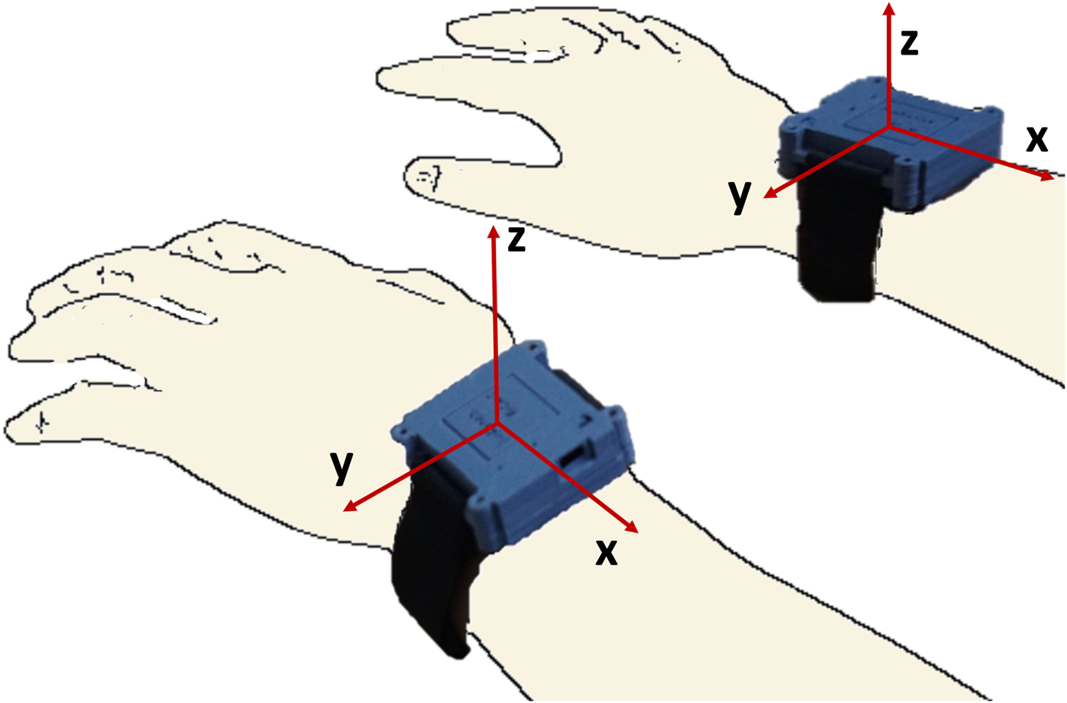
Clinical Dilemma in Rehabilitation
Single-Sensor Wrist Tracking
Deploying a single wrist-worn IMU is optimal for patient compliance in remote therapy. However, wrist, elbow, and shoulder movements generate overlapping kinematic signals at the wrist.
Limitations of Existing Methods
Single-Channel Limitations: Standard single-channel or basic X,Y,Z signals miss multi-axis coordination across joint movements.
High On-Device Cost: Running high-dimensional time-series analytics on smartwatches causes severe battery drain and memory overhead.
Notes:
In remote upper-limb rehabilitation, tracking whether an exercise correctly targets the wrist, elbow, or shoulder is essential. While using a single wrist-worn sensor is ideal for patient comfort, it introduces two major technical bottlenecks.
First, arm joint movements produce overlapping kinematic signals at the wrist. Existing approaches often evaluate channels in isolation or rely on standard $X,Y,Z$axes, which fail to capture the multi-axis coordination—like rotation coupled with gravitational tilt—that distinguishes an elbow motion from a shoulder motion.
Second, there is a heavy computational dilemma. Running high-dimensional motion analytics directly on a smartwatch is far too resource-intensive and drains battery fast.
Our approach solves this by shifting the heavy lifting offline. During model preparation, we generate an over-complete pool of over 3,000 multi-channel combination features. We then use RUSBoost feature selection offline to permanently prune away uninformative combinations. As a result, the smartwatch itself never calculates those 3,000+ candidate features—it only executes a compact, 75-feature algorithm, drastically reducing on-device compute while preserving high joint-level accuracy

Slide 3
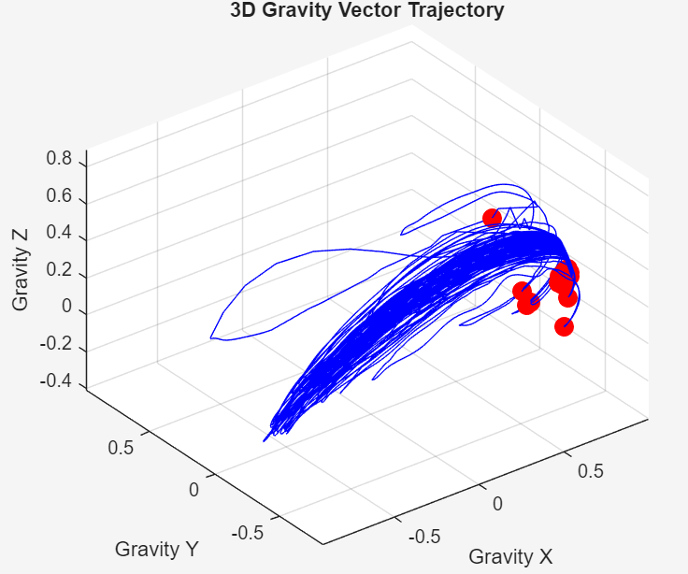

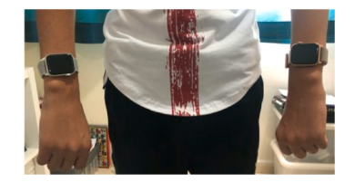

Cycles & DTW Medoid Baseline
Our Dataset
The HemiPhysioData App is a WatchOS app that runs on Apple Watch.
Data were collected from three adult participants
Type of movement performed – elbow extension/flexion (el-exfl), shoulder extension/flexion (sh-exfl), and wrist pronation/ supination (wr-prsu)
Cycle Detection
Autocorrelation segments continuous IMU streams into complete, biomechanically meaningful repetitions normalized to samples.
Notes:
To overcome the limitations of sliding windows, our framework operates on complete, biomechanically meaningful movement cycles. We segment self-paced repetitions using autocorrelation and resample each cycle to $T=100$ time points.
To align varying movement speeds without phase distortion, we use Dynamic Time Warping (DTW). But the core innovation of our methodology lies in how we define reference templates.
Traditional DTW pipelines construct reference templates by mathematically averaging aligned signals. These synthetic centroids create non-physical trajectories that no human has ever actually performed.
Instead, we strictly use Class Medoids. A medoid is an actual recorded training cycle that minimizes total DTW distance to all other cycles within its class.
Why does this matter? Because a medoid is a real, physical movement. Physical therapists can visualize, replay, and physically audit the exact baseline templates used by the algorithm

Slide 4


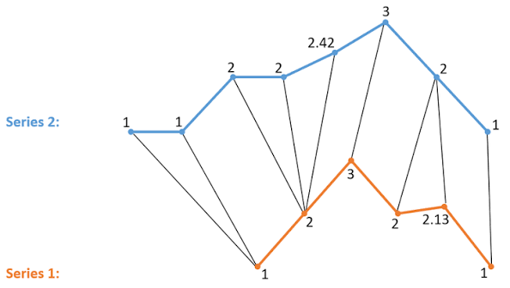
Cycles & DTW Medoid Baseline
Dynamic Time Warping
Class Medoids
Multivariate DTW nonlinearly aligns movement repetitions executed at varying speeds without phase distortion, preserving temporal dynamics.
Instead of synthetic centroids (which produce unphysical average trajectories), medoids are real recorded cycles minimizing intra-class DTW distance for clinical replay.
Notes:
To overcome the limitations of sliding windows, our framework operates on complete, biomechanically meaningful movement cycles. We segment self-paced repetitions using autocorrelation and resample each cycle to $T=100$ time points.
To align varying movement speeds without phase distortion, we use Dynamic Time Warping (DTW). But the core innovation of our methodology lies in how we define reference templates.
Traditional DTW pipelines construct reference templates by mathematically averaging aligned signals. These synthetic centroids create non-physical trajectories that no human has ever actually performed.
Instead, we strictly use Class Medoids. A medoid is an actual recorded training cycle that minimizes total DTW distance to all other cycles within its class.
Why does this matter? Because a medoid is a real, physical movement. Physical therapists can visualize, replay, and physically audit the exact baseline templates used by the algorithm

Slide 5
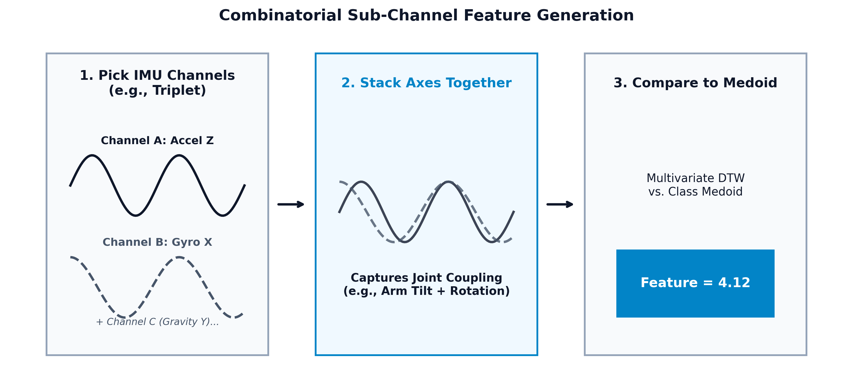

Combinatorial Feature Space
Multi-Axis Coupling
Upper limb motions engage multiple sensor channels simultaneously (e.g., rotation coupled with gravitational acceleration shifts).
From 19 IMU channels, structured sub-channel combinations are constructed:
• Single Channels: $\left({19 \atop 1}\right)=19$ Subsets
• Channel Pairs: $\left({19 \atop 2}\right)=171$ Subsets
• Channel Triplets: $\left({19 \atop 3}\right)=969$ Subsets
3,477 Features
1,159 sub-channels × 3 class medoids
Notes:
Biomechanical movement relies on multi-axis coordination. Evaluating individual sensor channels alone misses coupled motions, while computing DTW across all 19 channels simultaneously introduces significant noise.
To capture coupled dynamics, we construct a structured feature pool across:
Type 1 (Single Channels): $\binom{19}{1} = 19$ subsets
Type 2 (Channel Pairs): $\binom{19}{2} = 171$ subsets
Type 3 (Channel Triplets): $\binom{19}{3} = 969$ subsets
Evaluating DTW distances across these 1,159 sub-channel combinations against our 3 class medoids yields an over-complete feature pool of 3,477 DTW distance features.

Slide 6
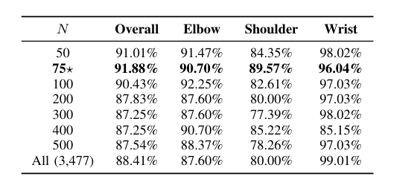
Ensemble Feature Selection
75
RUSBoost & "Less is More"
Addressing Redundancy: Evaluating all 3,477 combinatorial DTW features introduces noise and severe multicollinearity.
Optimal Selected Features
Class Imbalance: RUSBoost embeds random undersampling into boosting iterations to handle unequal cycle counts and rank predictor importance.
Performance Peak: Classification accuracy peaks sharply at N = 75 (91.88%). Retaining all 3,477 features drops accuracy to 88.41% (>3% lower).
Notes:
An over-complete pool of 3,477 features introduces high multicollinearity and redundant noise. Furthermore, real-world motion data suffers from natural class imbalance due to unequal repetition counts.
To solve both issues, we employ RUSBoost—which integrates random undersampling into boosting iterations to rank feature importance while handling class imbalance.
Our empirical analysis demonstrated a classic 'less is more' outcome:
Model accuracy peaks sharply at $N = 75$ selected features, reaching 91.88% overall accuracy.
Evaluated on the full 3,477 feature set, performance drops to 88.41%—more than a 3 percentage point drop.
Beyond 75 features, additional channels add variance rather than discriminative signal. Feature selection isn't just a compression step; it is what isolates the core kinematic interactions.

Slide 7
Ensemble Feature Selection
Notes:
An over-complete pool of 3,477 features introduces high multicollinearity and redundant noise. Furthermore, real-world motion data suffers from natural class imbalance due to unequal repetition counts.
To solve both issues, we employ RUSBoost—which integrates random undersampling into boosting iterations to rank feature importance while handling class imbalance.
Our empirical analysis demonstrated a classic 'less is more' outcome:
Model accuracy peaks sharply at $N = 75$ selected features, reaching 91.88% overall accuracy.
Evaluated on the full 3,477 feature set, performance drops to 88.41%—more than a 3 percentage point drop.
Beyond 75 features, additional channels add variance rather than discriminative signal. Feature selection isn't just a compression step; it is what isolates the core kinematic interactions.

Slide 8
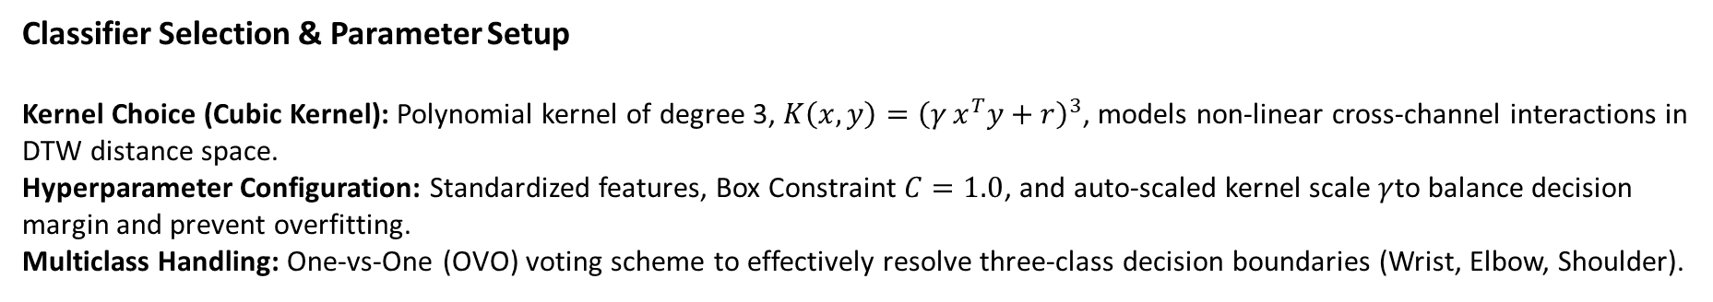
End-to-End Execution Pipeline
2. Cycle Extraction
Autocorrelation segments continuous motion into T=100 cycles.
4. Cubic SVM
Polynomial kernel outputs joint classification (91.88% Accuracy).
1. Stream Acquisition
3. Medoid DTW
19 IMU raw channels captured at 100 Hz from wrist watch.
Distances evaluated across 75 selected sub-channels against 3 medoids.
Classifier Selection & Parameter Setup
Kernel Choice (Cubic Kernel): Polynomial kernel of degree 3, $K\left(x,y\right)={\left(γ x^{T}y+r\right)}^{3}$, models non-linear cross-channel interactions in DTW distance space.
Hyperparameter Configuration: Standardized features, Box Constraint $C=1.0$, and auto-scaled kernel scale $γ$to balance decision margin and prevent overfitting.
Multiclass Handling: One-vs-One (OVO) voting scheme to effectively resolve three-class decision boundaries (Wrist, Elbow, Shoulder).

Slide 9
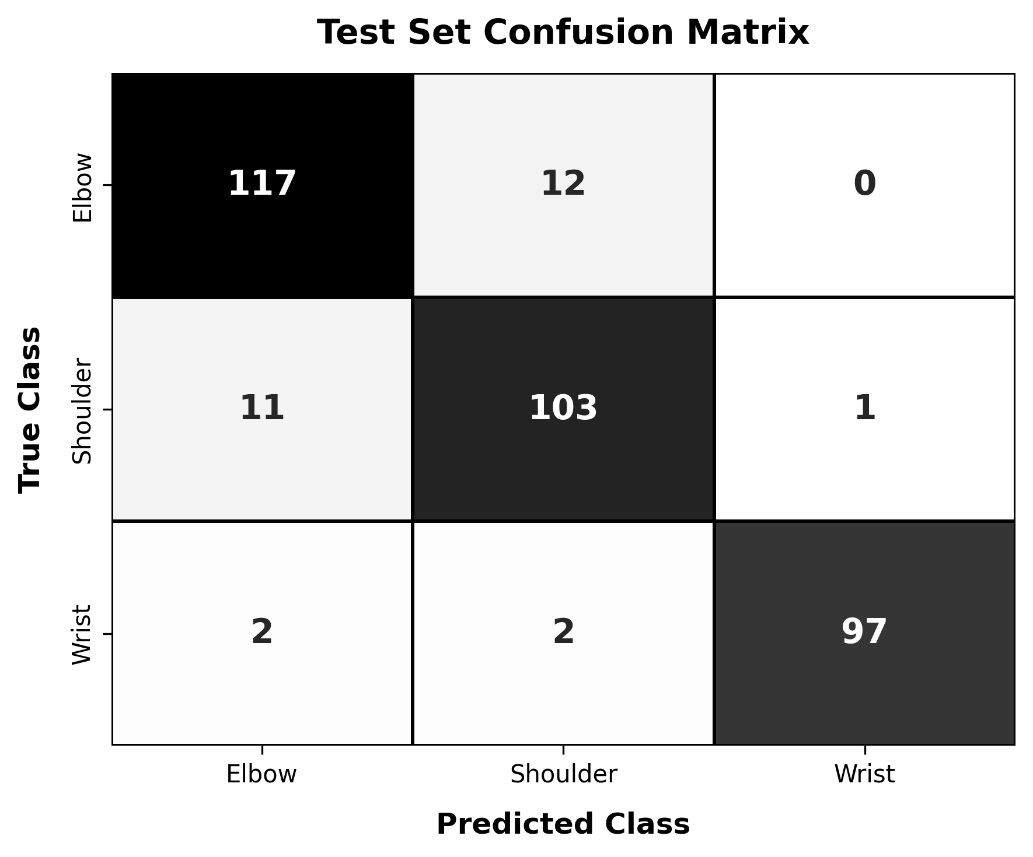
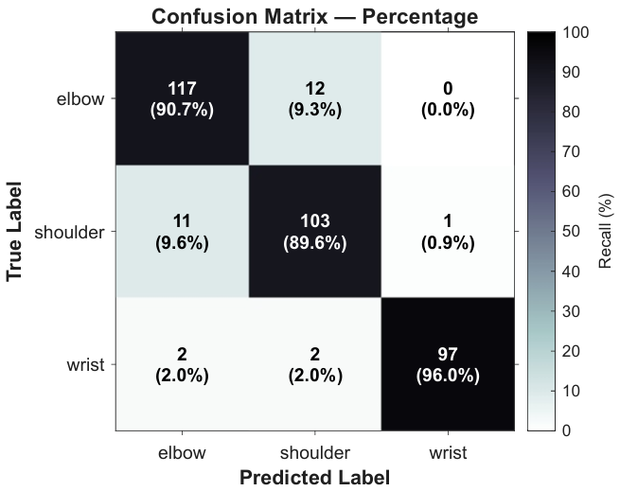
Results

Slide 10
Diagnostic Metrics & Coupling
Joint Class | Accuracy | Recall | ROC-AUC
Wrist | 96.04% | 0.998 | 0.991
Elbow | 86.84% | 0.981 | 0.624
Shoulder | 89.57% | 0.982 | 0.865
Macro Average | 91.9% | 92.1% | 0.987
Strong Global Separability: Near-perfect macro ROC-AUC (0.987) confirms that 75 combinatorial DTW features effectively resolve cross-joint class boundaries.
High-Precision Wrist Isolation: Exceptional wrist performance (96.0% accuracy, 0.998 AUC) is driven by distinct rotational gyroscopic signals (pronation/supination).
Physiological Kinematic Coupling: Minor performance drop in elbow and shoulder classes reflects natural anatomical movement, where shoulder activation drags elbow trajectory.
Threshold Sensitivity: The high AUC relative to recall demonstrates robust class probability ranking across all operating points.
Notes:
Using a Cubic Polynomial SVM trained on these 75 features, we achieved an overall macro F1-score of 0.922 and an AUC of 0.987.
Looking at individual joint performance:
Wrist movements are isolated almost perfectly at 96.04% recall, thanks to distinct gyroscopic rotation signatures.
Elbow vs. Shoulder exhibits minor bidirectional confusion (12 elbow cycles misclassified as shoulder; 11 shoulder as elbow) due to anatomical kinematic coupling between proximate joints.
Now, I want to draw your attention to a critical methodological finding: Average Precision versus AUC.
While the Elbow class exhibits a high AUC of 0.981, its Average Precision (AP) drops to 0.624. Precision-Recall curves reveal that elbow precision degrades past moderate recall—a trade-off that ROC curves completely obscure. In clinical motion analysis, reporting PR metrics alongside ROC curves is mandatory to avoid overoptimistic assessments."

Slide 11
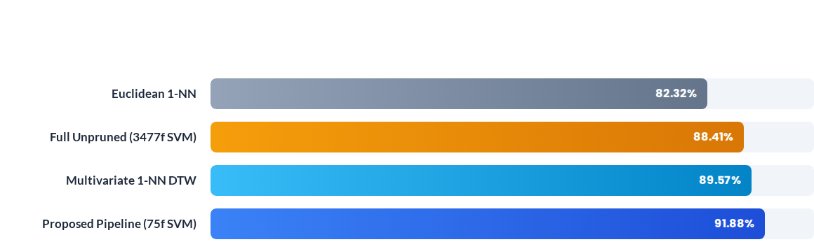
Benchmark Performance
Runtime Efficiency Advantage: While accuracy gains over 1-NN DTW are comparable, 1-NN DTW requires computing full 19-channel DTW against every training cycle. The proposed medoid pipeline yields a ~46-fold runtime reduction suitable for wearable edge deployment.
Notes:
We benchmarked our pipeline against standard time-series classifiers:
Euclidean 1-NN achieved 82.32%, with shoulder accuracy falling to 66.96%. The 7.25% drop confirms that non-linear temporal alignment is necessary to handle timing variability.
Multivariate 1-NN DTW achieved 89.57%.
Our Proposed Pipeline reached 91.88% overall accuracy.
While a paired McNemar test shows the accuracy gain over 1-NN DTW is not statistically significant ($\chi^2 = 1.88, p = 0.170$), our pipeline provides a massive computational advantage.
Standard 1-NN DTW requires computing expensive 19-channel DTW alignments against every training cycle at runtime. Our pipeline evaluates DTW distance against only 3 static medoids over low-dimensional sub-channels, achieving approximately a 46-fold compute reduction—making it realistic for embedded deployment.

Slide 12
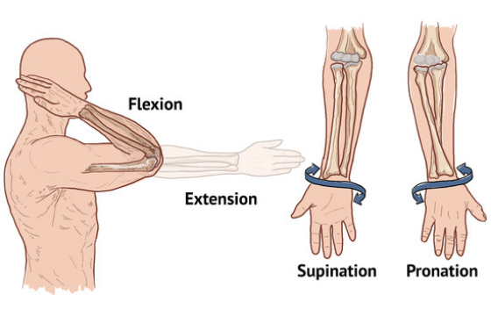
Clinical Impact & Future Scope
Clinical Impact
Physical Therapist Auditing: Class medoids represent actual physical patient trials, allowing clinicians to visually replay and verify baseline templates.
Microcontroller Deployment: Computing distances against only 3 static medoids drastically cuts RAM and battery draw for real-time wearables.
Future Scope
Developing multi-joint prototype templates to resolve elbow-shoulder coupling.
Validating the pipeline on larger cohorts using subject-independent cross-validation.
Benchmarking real-time power draw and latency on wearable microcontrollers
Notes:
In conclusion, we have presented a clinically interpretable joint classification framework that pairs single-sensor IMU data with real movement medoids and ensemble feature selection.
By extracting 75 structured features out of 3,477 candidates, we improved accuracy by over 3 percentage points while maintaining full auditability for clinicians.
Moving forward, our future work focuses on:
Validating the pipeline on larger cohorts using subject-independent cross-validation.
Developing multi-joint prototype templates to resolve elbow-shoulder coupling.
Benchmarking real-time power draw and latency on wearable microcontrollers.
Thank you for your time, and I am happy to open the floor to any questions.

Slide 13

Questions & Discussion
Thank you for your attention.
fflitti@hct.ac.ae | ybenachour@hct.ac.ae | mrehman@hct.ac.ae

